Slide 1
6. Optimization Non-Linear Optimization
Laura Hervert Escobar

Slide 2
Non linear optimization
Nonlinear programming problem is a direct extension of linear programming where we replace linear model functions by nonlinear ones.
In many real-life problems, the objective function may be nonlinear but the set of constraints may be linear or non linear and the most general class of optimization problems is the class of problems where both the objective function and the constraints are nonlinear.

Slide 3
Quadratic programming
Quadratic programming (QP) is the problem of optimizing a quadratic objective function and is one of the simplest form of non-linear programming.
The objective function can contain bilinear or up to second order polynomial terms,
The constraints are linear and can be both equalities and inequalities.
QP is widely used in image and signal processing, to optimize financial portfolios, to perform the least-squares method of regression, to control scheduling in chemical plants, and in sequential quadratic programming, a technique for solving more complex non-linear programming problems.

Slide 4

Problem Formulation
A general quadratic programming formulation contains a quadratic objective function and linear equality an inequality constraints
The objective function is arranged such that the vector q containst all of the (single differentiated) linear terms and Q contains all of the (twice differenciated) quadratic terms.
$$\begin{matrix}minf\left(x\right)=q^{T}x+\frac{1}{2}x^{T}Qx \\ s.t \\ Ax=a \\ Bx≤b \\ x≥0\end{matrix}$$
Put more simply, Q is the Hessian matrix of the objective function and q is its gradient.

Slide 5
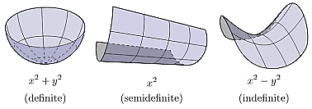
Global solutions
If the objective function is convex, then any local minimum found is also the sole global minimum.
To analyze the function’s convexity, one can compute its Hessian matrix and verify that all eigenvalues are positive, or, equivalently, one can verify that the matrix Q is positive definite.
This is a sufficient condition, meaning that it is not required to be true in order for a local minimum to be the unique global minimum, but will guarantee this property holds if true

Slide 6

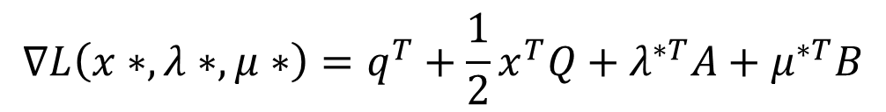

Optimality
Solutions can be tested for optimality using Karush-Kuhn-Tucker conditions just as is done for other nonlinear problems:
Condition 1: sum of gradients is zero:
Condition 2: all constraints satisfied:
Condition 3: complementary conditions:
$$∇L\left(x∗,λ∗,μ∗\right)=q^{T}+\frac{1}{2}x^{T}Q+λ^{∗T}A+μ^{∗T}B$$
$$\begin{matrix}Ax∗−a=0 \\ Bx∗−b≤0\end{matrix}$$
$$\begin{matrix}μ^{T}Bx−b=0 \\ x^{T},λ^{T},μ^{T}≥0\end{matrix}$$

Slide 7
Scypy
Is a free and open-source Python library used for scientific computing and technical computing
constants: physical constants and conversion factors
cluster: hierarchical clustering, vector quantization, K-means
fft: Discrete Fourier Transform algorithms
fftpack: Legacy interface for Discrete Fourier Transforms
integrate: numerical integration routines
interpolate: interpolation tools
io: data input and output
lib: Python wrappers to external libraries
linalg: linear algebra routines
misc: miscellaneous utilities (e.g. image reading/writing)
ndimage: various functions for multi-dimensional image processing
optimize: optimization algorithms including linear programming
signal: signal processing tools
sparse: sparse matrix and related algorithms
spatial: KD-trees, nearest neighbors, distance functions
special: special functions
stats: statistical functions
weave: tool for writing C/C++ code as Python multiline strings

Slide 8
Scypy
The minimize function provides algorithms for constrained minimization, namely 'trust-constr' , 'SLSQP' and 'COBYLA'.
They require the constraints to be defined using slightly different structures.
The method 'trust-constr' requires the constraints to be defined as a sequence of objects LinearConstraint and NonlinearConstraint.
Methods 'SLSQP' and 'COBYLA', on the other hand, require constraints to be defined as a sequence of dictionaries, with keys type, fun and jac.

Slide 9
CVXOPT
CVXOPT is a free software package for convex optimization based on the Python programming language.
It can be used with the interactive Python interpreter, on the command line by executing Python scripts, or integrated in other software via Python extension modules.
Its main purpose is to make the development of software for convex optimization applications straightforward by building on Python’s extensive standard library and on the strengths of Python as a high-level programming language

Slide 10
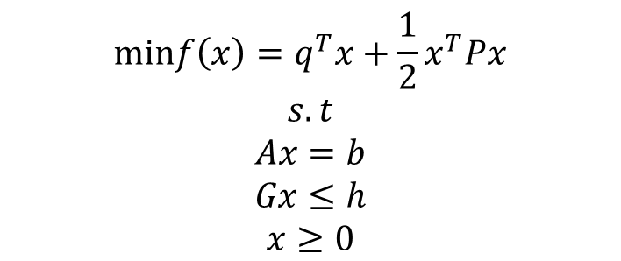
$$\begin{matrix}minf\left(x\right)=q^{T}x+\frac{1}{2}x^{T}Px \\ s.t \\ Ax=b \\ Gx≤h \\ x≥0\end{matrix}$$
The CVXOPT QP framework expects a problem of the above form, defined by the parameters {P; q; G; h; A; b}; P and q are required, the others are optional.
Alternate QP formulations must be manipulated to conform to the above form; for example, if the inequality constraint was expressed as Gx ≥ h, then it can be rewritten -Gx ≤ -h.
Also, to specify lower and upper bounds on x, an identity matrix can form part of G, since x ≤ u is equivalent to Ix ≤ u. Note that x itself is not provided to the solver, since it is an internal variable being optimized over.
In particular, this means that the solver has no explicit knowledge of x itself; everything is implicity defined by the supplied parameters.
It is essential that the same variable order is maintained for the relevant parameters (e.g., q_{i}; h_{i}; b_{i} should correspond to variable x_{i}).

Slide 11
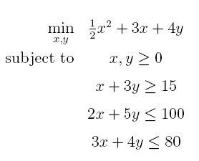
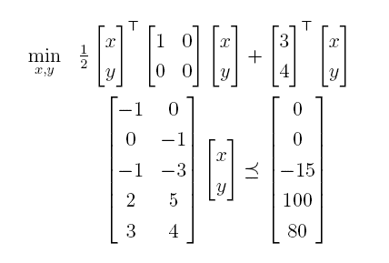

Example
$$\begin{matrix}minf\left(x\right)=q^{T}x+\frac{1}{2}x^{T}Px \\ s.t \\ Ax=b \\ Gx≤h \\ x≥0\end{matrix}$$

Slide 12
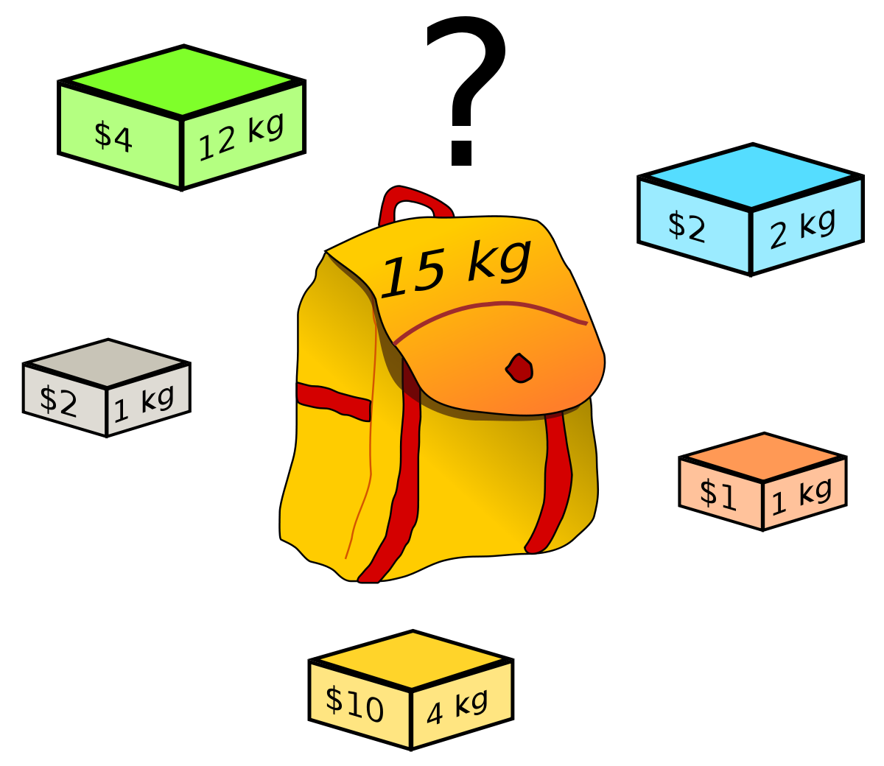
Knapsack problem
Given a set of items, each with a weight and a value, determine the number of each item to include in a collection so that the total weight is less than or equal to a given limit and the total value is as large as possible.
It derives its name from the problem faced by someone who is constrained by a fixed-size knapsack and must fill it with the most valuable items.
The problem often arises in resource allocation where the decision makers have to choose from a set of non-divisible projects or tasks under a fixed budget or time constraint, respectively.

Slide 13
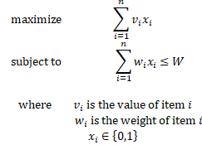
Problem formulation (linear approach)

